Slide 1
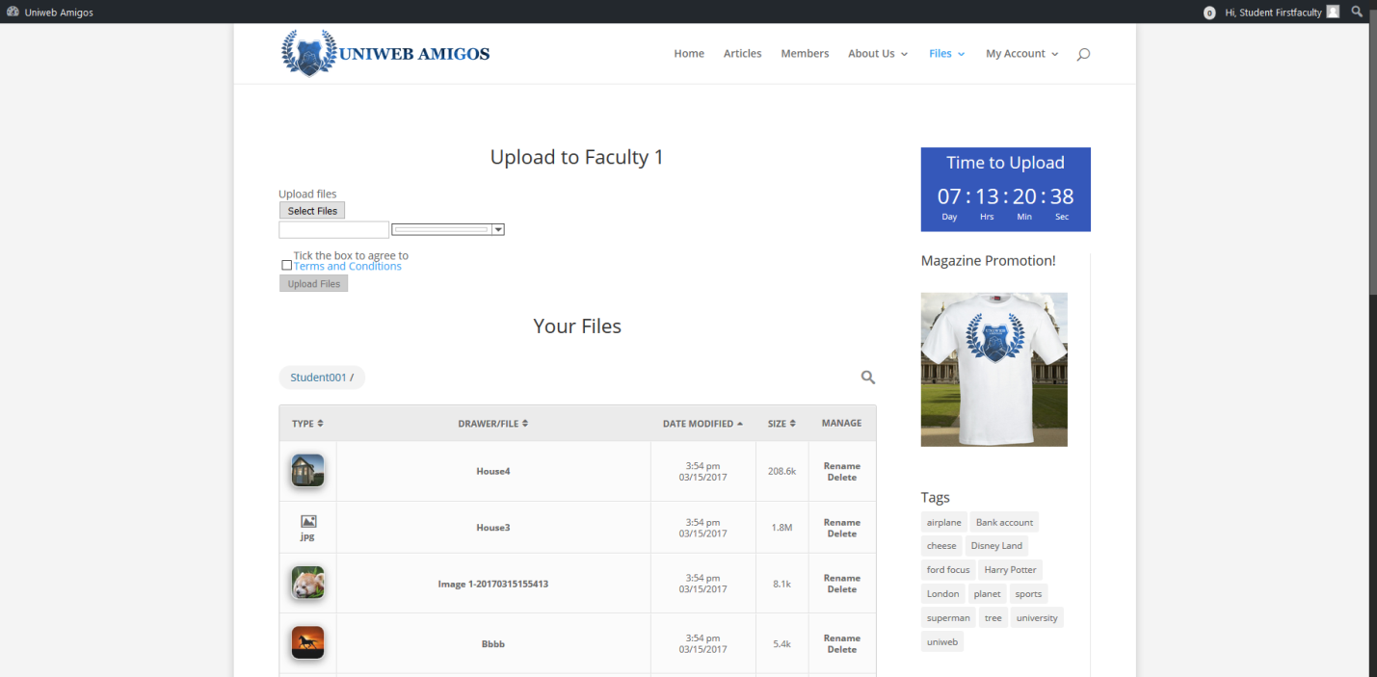
Student Account Functionality
Student Functions & Features
On login a student, user is presented with activity screen for uploading files to the system, along with all files that the user has uploaded in a table.

Slide 2
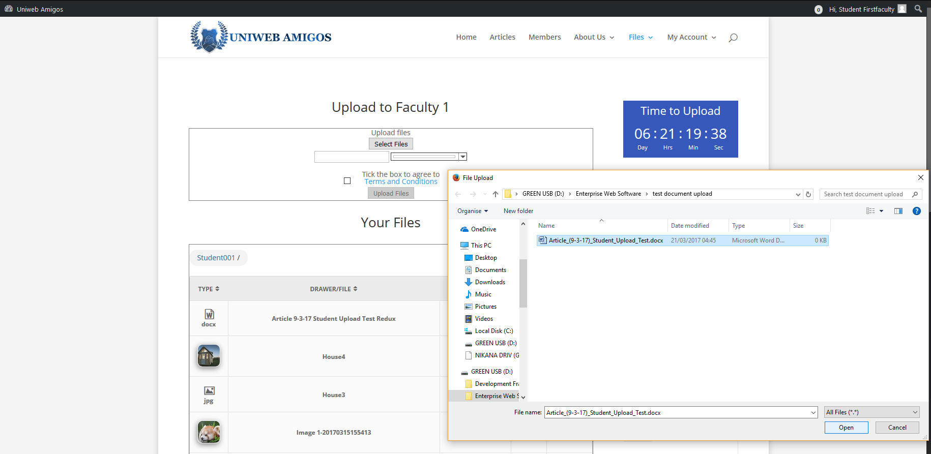
Choosing the select files option enables report document uploads, but can only be submitted for approval by a coordinator by checking the terms and conditions box, doing so unlocks the upload button

Slide 3
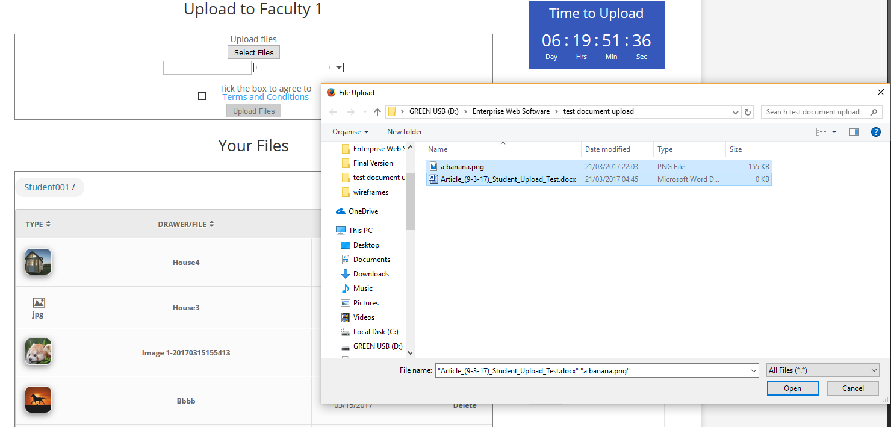
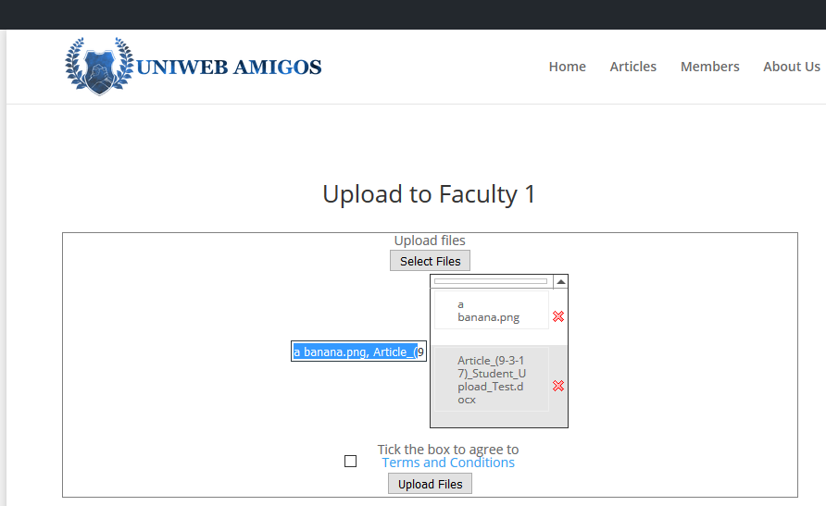
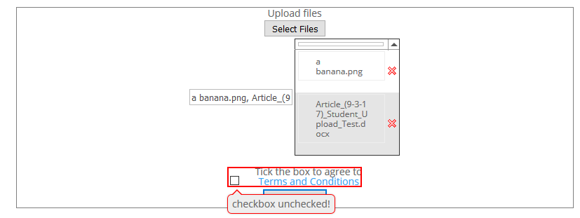
Several items can be selected for a single upload
Upload confirmation requires user to agree to attached terms and conditions

Slide 4
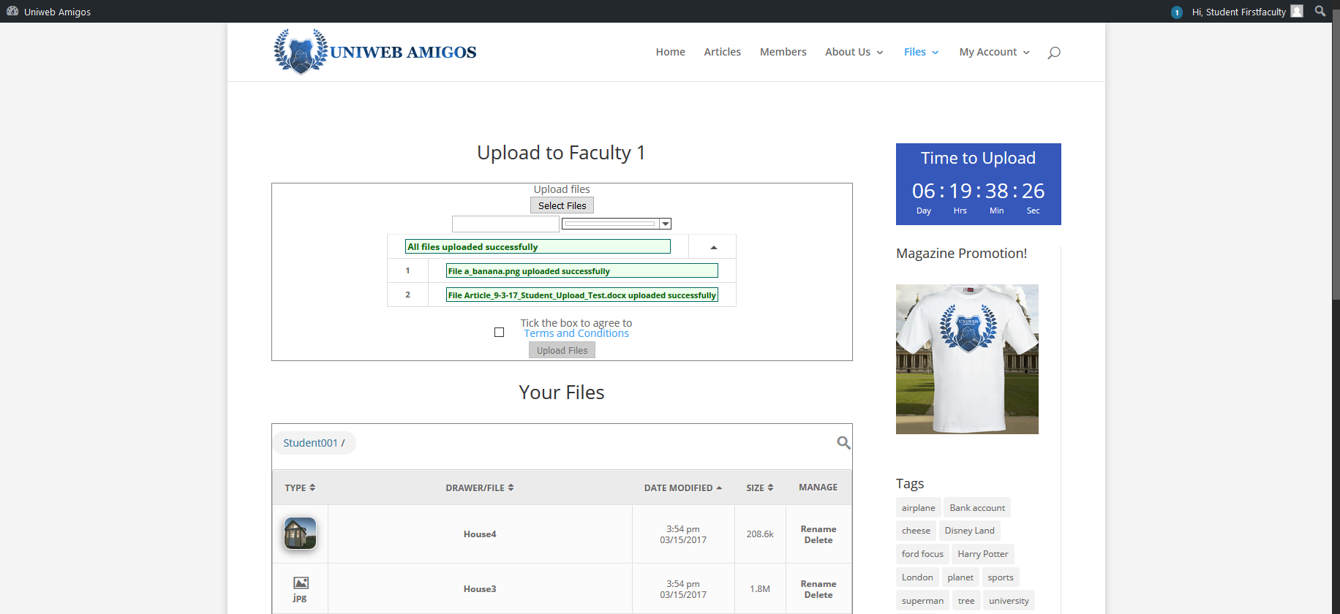
- Uploads will be stored within the users server space for later selection

Slide 5
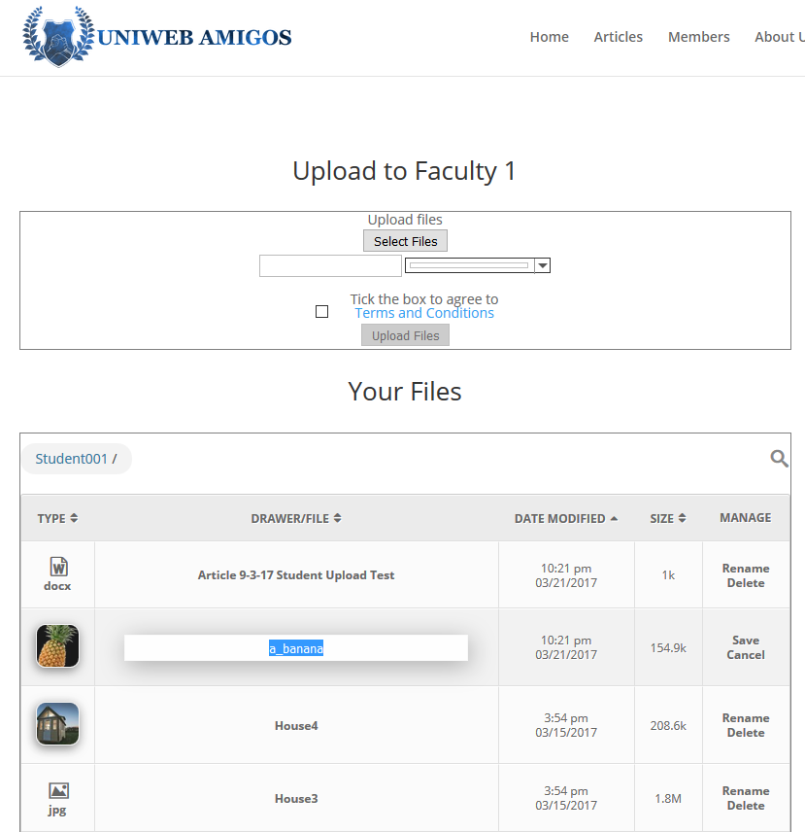
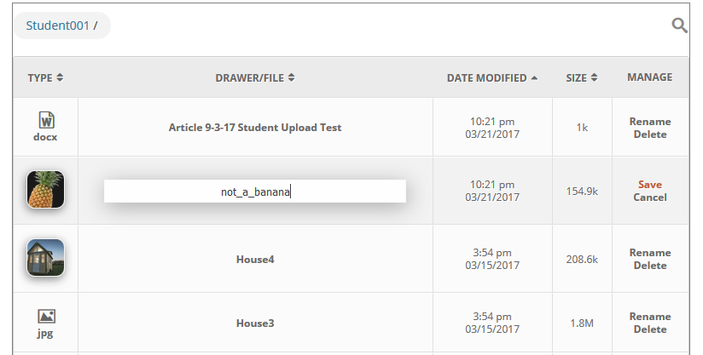
New uploads require the user to refresh the page
The ‘Manage’ tab features basic options for editing and removing files while on the site

Slide 6
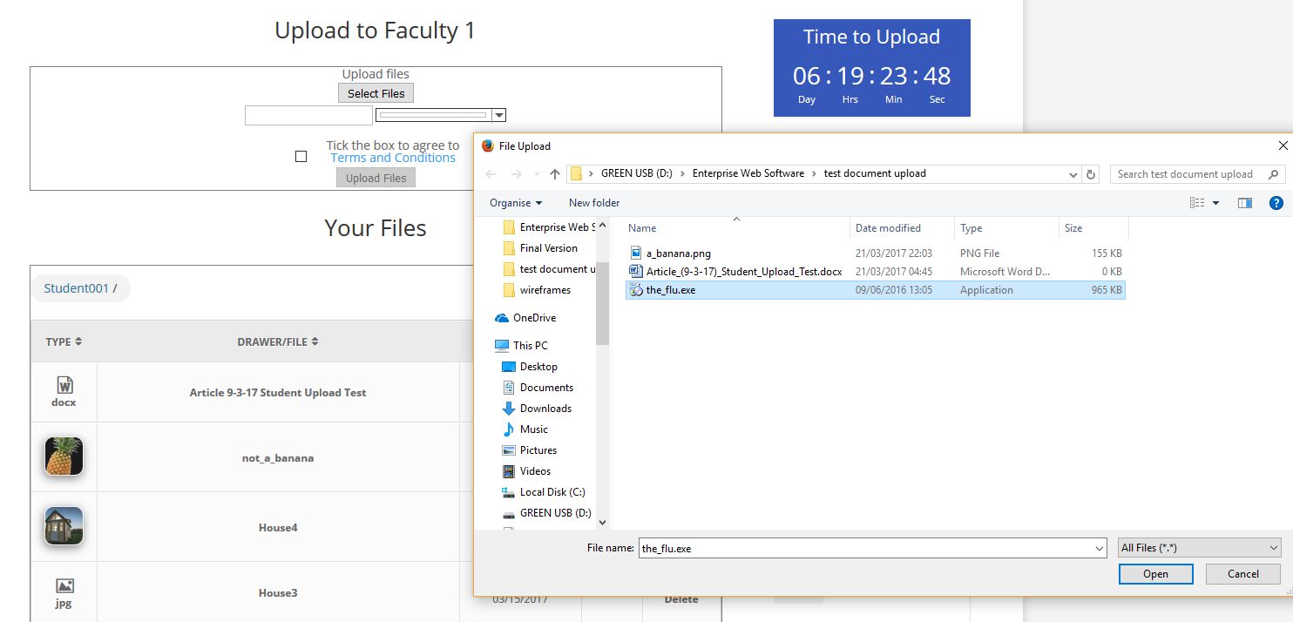

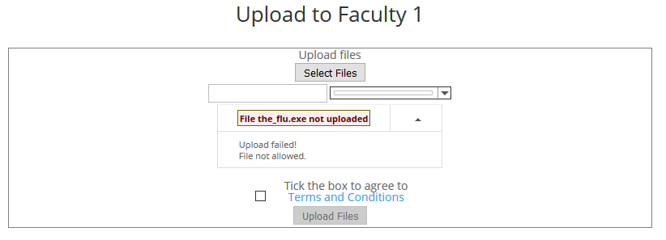
Upload is restricted for invalid file types
More control over the entities being hosted

Slide 7
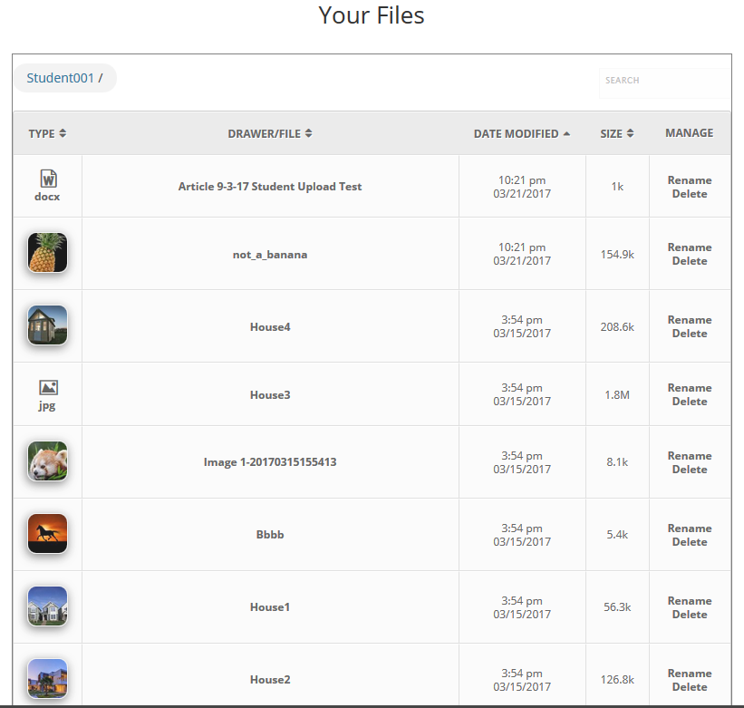
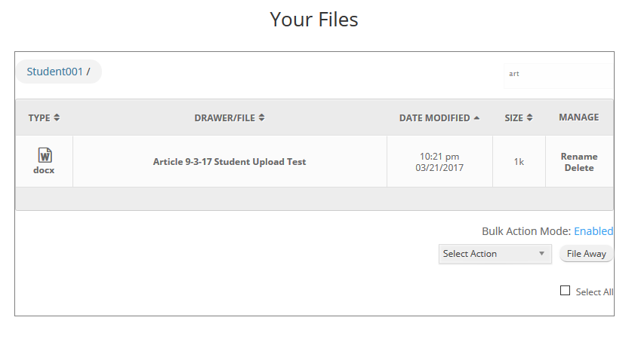


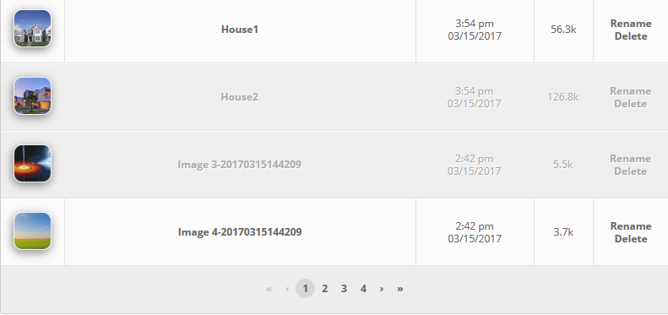
The User library includes search, filter and navigation options for handling
Beneath said library is a bulk action setting for functions influencing larger batches of files.
Files can be selected for this through left-clicking
Potentially this allows the transmitting of files between users

Slide 8
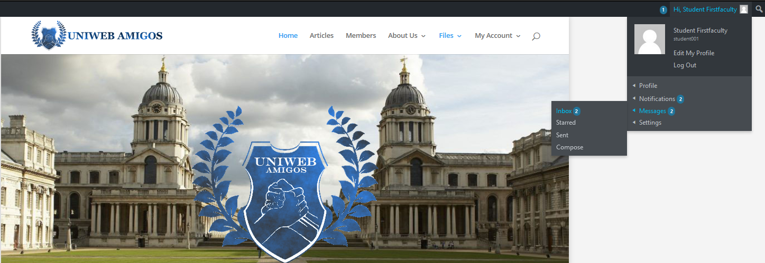
Account Communication Features

Slide 9
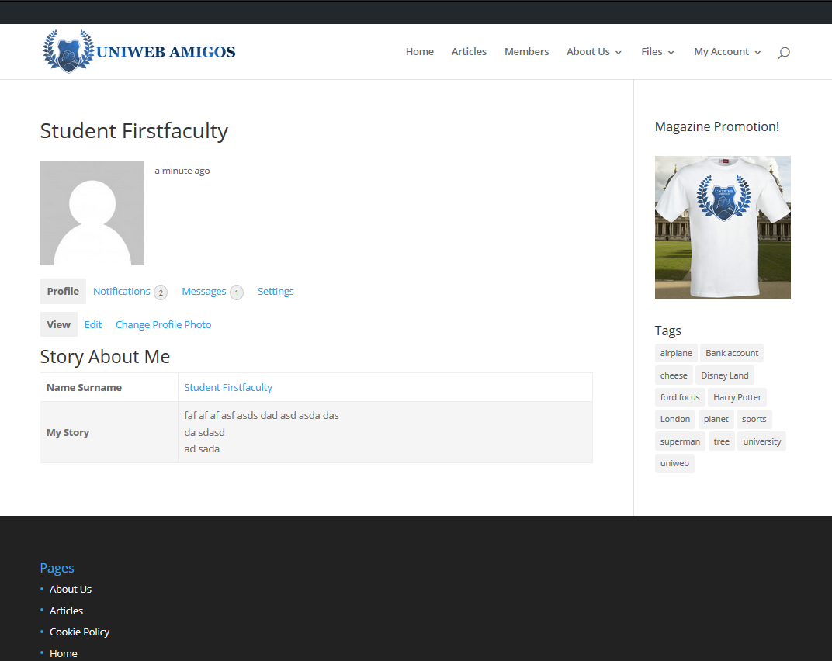
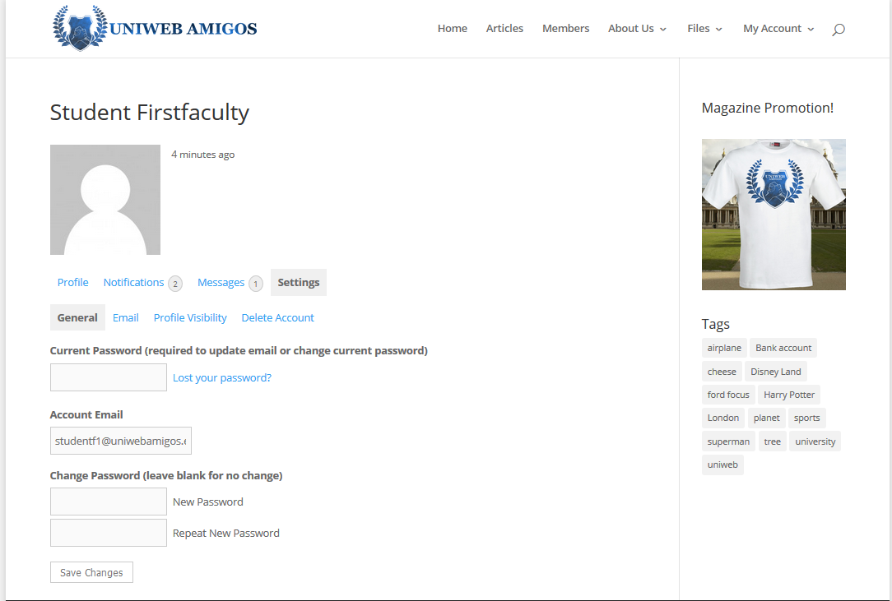
Student Account Settings & Details
Account profile view, basic summary of account or user
Features links to inter and intra communications
Grants access to user account settings, for control over personal details & account security

Slide 10
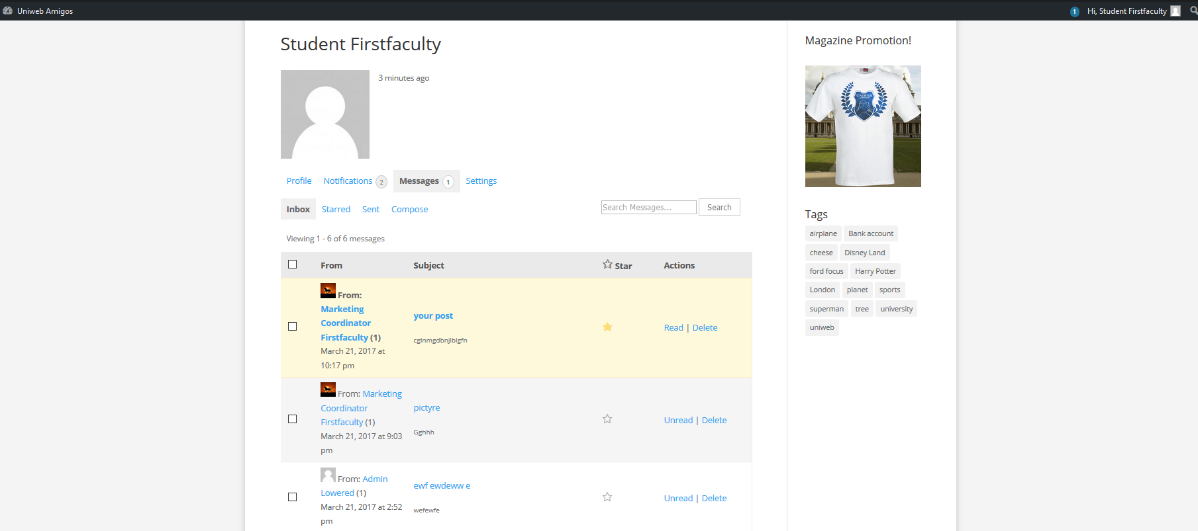
Internal account communications & notifications hub

Slide 11
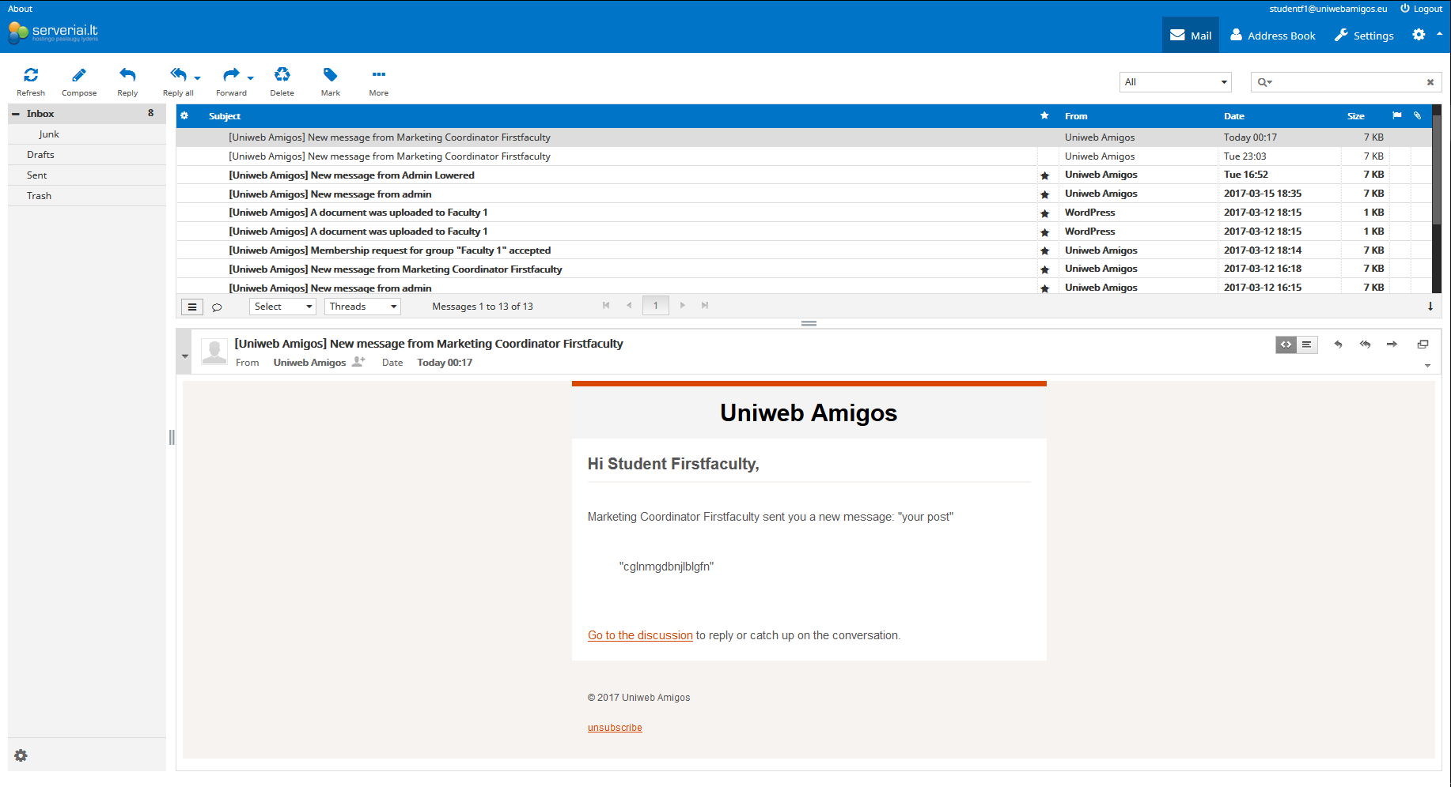
Account notifications are also available externally via webmail client.

